Slide 1
Priority Queues, Heaps Trees and Heap sort

Slide 2
Priority Queues
A priority queue is a collection of zero or more elements → each element has a priority or value.
Operations performed on priority queues:
1) Find an element, 2) insert a new element, 3) delete an element, etc.
Two kinds of (Min, Max) priority queues exist
In a Min priority queue, find/delete operation finds/deletes the element with minimum priority
In a Max priority queue, find/delete operation finds/deletes the element with maximum priority
Two or more elements can have the same priority

Slide 3
Implementation of Priority Queues
Implemented using heaps
Heap is a complete binary tree that is efficiently stored using the array-based representation

Slide 4
Max (Min) Tree
A max tree (min tree) is a tree in which the value in each node is greater (less) than or equal to those in its children (if any)
Nodes of a max or min tree may have more than two children (i.e., may not be binary tree)

Slide 5
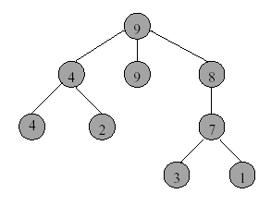

Max Tree Example

Slide 6
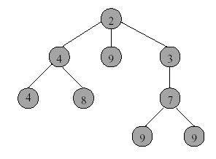

Min Tree Example

Slide 7
Heaps - Definitions
A max heap (min heap) is a max (min) tree that is also a complete binary tree
14
12
7
10
8
6
max Heap
max tree + complete binary tree

Slide 8
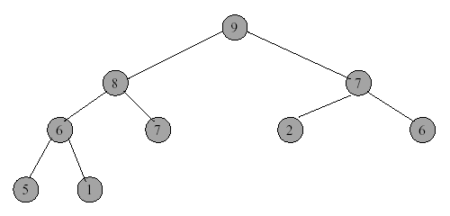

Max Heap with 9 Nodes

Slide 9
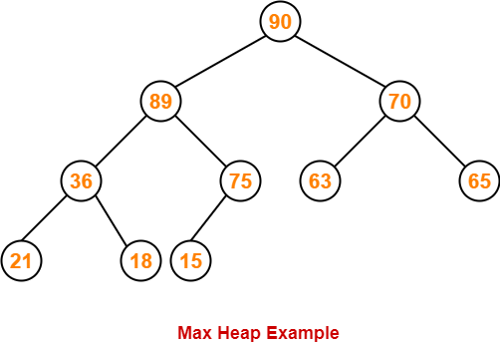

Slide 10
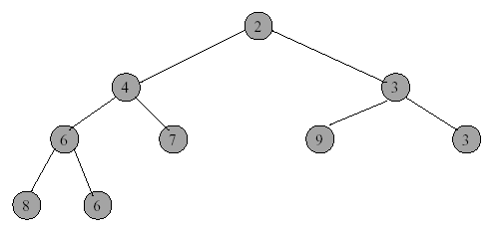

Min Heap with 9 Nodes
min Heap
Min tree + complete binary tree

Slide 11
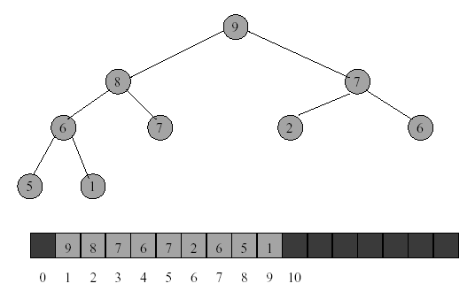
Array Representation of Heap
A heap is efficiently represented as an array.
1
2 X i = left child position
2
3
2 X i +1 = right child position
5
6
7
4
8
9

Slide 12
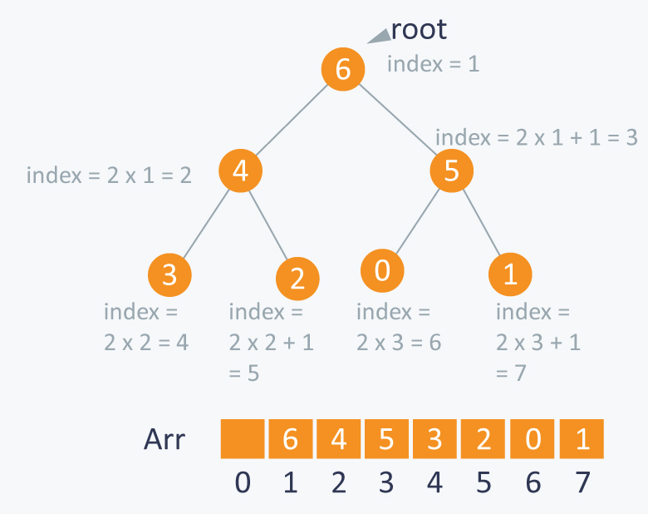

Slide 13
Heap Operations
When n is the number of elements (heap size),
Insertion ➔ O(log₂n)
Deletion ➔ O(log₂n)
Initialization ➔ O(n)

Slide 14
Pseudocode for Adding an Element:
Place the new element in the heap in the first available location. This keeps the structure as a complete binary tree, but it might no longer be a heap since the new element might have a greater value than its parent.
If parent element is smaller than the new element , then move down the parent element
Step 2 will stop when the new element reaches the root or when the new element’s parent has a value greater than or equal to the new element's value.

Slide 15
Insertion into a Max Heap
Insert(18)
Step-1
80
1
17
2
35
3
1
15
4
14
5
30
6
20
7
8
9
11
12
13
14
15
10
12
8
10
9
25
22
11
2

Slide 16

Insertion into a Max Heap
Step-1
80
1
Insert(18)
17
2
35
3
1
15
4
14
5
30
6
20
7
8
9
11
12
13
14
15
10
12
8
10
9
25
22
11
2
New element is 18
16
18
Newelepos/2=8
Pushdown parent ele
to child position since
Newele is > its parent
Newele=18
Newelepos=16

Slide 17

Step-2
80
17
35
15
14
30
20
Newelepos=8
Newele=18
12
8
9
25
22
11
2
10
New element is 18
Newelepos/2=4
Pushdown parent ele to child position since Newele is > its parent

Slide 18

Resultant Tree
80
17
35
Newelepos=4
Newelepos/2 =2
14
30
20
Newele=18
15
12
8
9
25
22
11
2
New element is 18
10

Slide 19

Step-3
Parent ele >Newele so stop comparison and place the newele in Newele position.
80
Newelepos=2
Newelepos/2 =1
Newele=18
35
17
14
30
20
15
12
8
9
25
22
11
2
New element is 18
10

Slide 20
Resultant tree after insertion
80
Newele=18
Newelepos=2
Newelepos/2 =1
18
35
17
14
30
20
15
12
8
9
25
22
11
2
10
Parent ele >Newele so stop comparison and place the newele in Newele position.

Slide 21
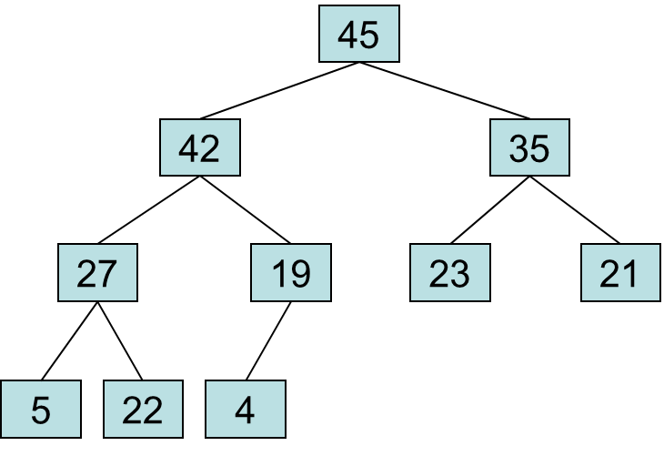
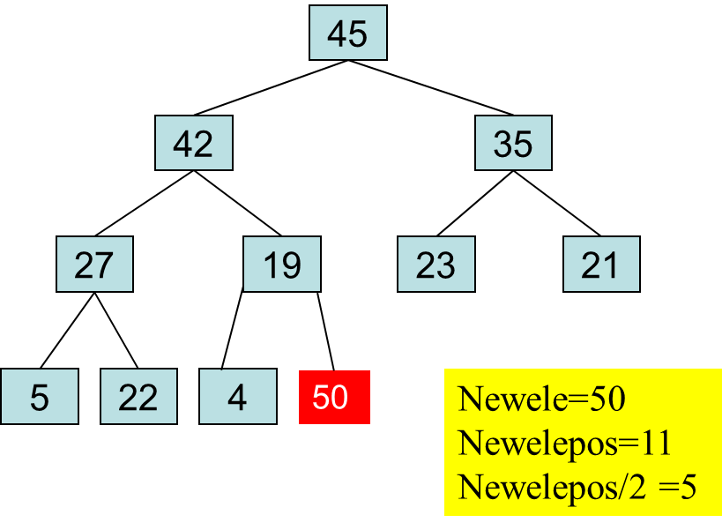
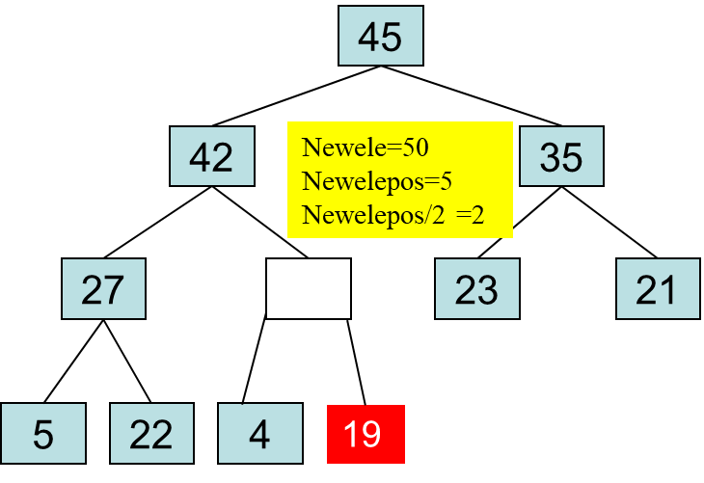
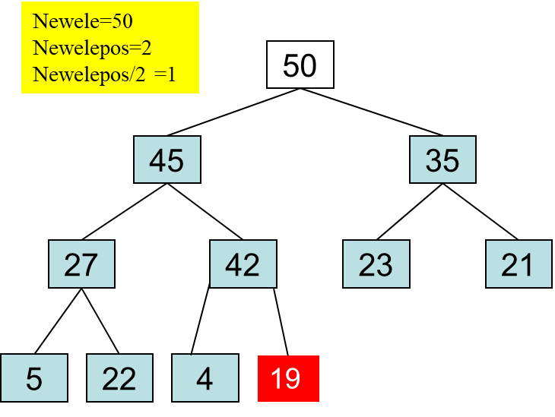
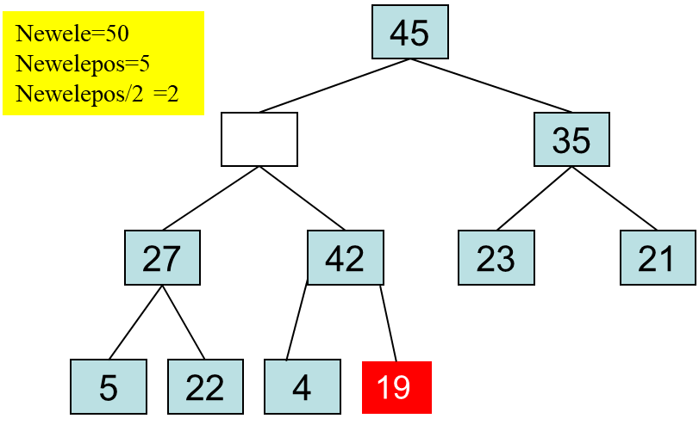
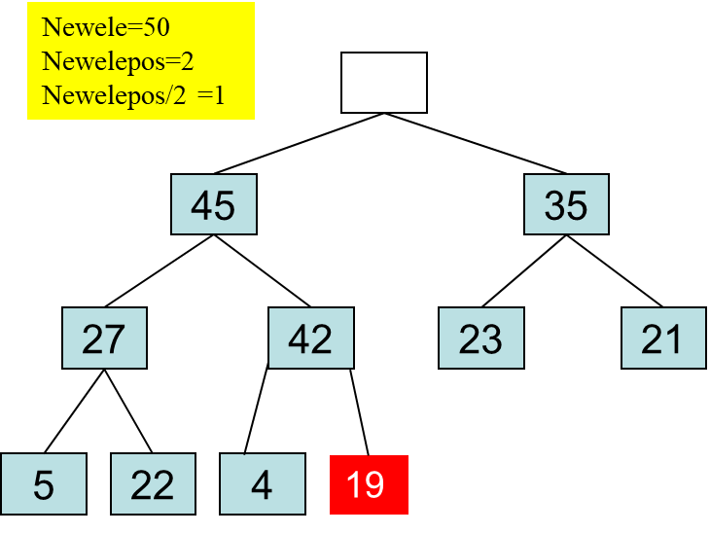



Given heap tree Insert 50

Slide 22
Psuedocode for Removing the Root:
Delete the root element
Move last element in the tree to the root
Heapify the tree
Now, think about how to build a heap. Check out the example of inserting 27, 35, 23, 22, 4, 45, 21, 5, 42 and 19 to an empty heap.

Slide 23
Deletion from heap tree
80
18
Ele to be deleted is
top element
35
17
14
30
20
15
12
8
9
25
22
11
2
10

Slide 24
Deletion from heap tree
18
35
17
14
30
20
15
12
8
9
25
22
11
2
10

Slide 25

Resultant tree after top element Deletion
Lastele=10
Parent=1
Now take the Last element and adjust to appropriate position
Child=3
18
35
17
14
30
20
15
12
8
9
25
22
11
2
Compare Lastele with child and move up the child ele since child ele is greater

Slide 26


Resultant Tree
35
Parent=3
Lastele=10
17
child=6
15
14
30
20
10
12
8
9
25
22
11
2

Slide 27

Resultat tree
35
18
30
Lastele=10
Parent=6
17
14
20
Child=12
15
12
8
9
25
22
11
2
again Compare Lastele with child and move up the child ele since child ele is greater than Lastele

Slide 28
Resultat tree
35
18
30
17
14
25
20
Lastele=10
Parent=12
15
12
8
9
22
11
2
Child=24
again Compare Lastele with child and move up the child ele
since child ele is greater than Lastele

Slide 29
Resultant tree
35
18
30
17
14
25
20
15
12
8
9
22
11
2
Lastele=10 , parent=12
child =24 ,Since 24 is greater than heapsize stop comparison and finally place
the Last ele in the current Parent.

Slide 30
Resultat tree
35
18
30
17
14
25
20
15
12
8
9
10
22
11
2

Slide 31

Given heap tree
Delete()
50
45
35
45
35
27
42
23
21
27
42
23
21
5
22
4
19
5
22
4
19
During delete
Before Delete()
Lastele=19
45
35
27
42
23
21
5
22
4
During delete

Slide 32

Given heap treeDelete()
45
Parent=2
Lastele=19
35
27
42
23
21
Child=5
5
22
4
During delete

Slide 33
45
42
35
Parent=5
27
Lastele=19
23
21
Child=10
5
22
4
During delete

Slide 34
45
42
35
Parent=5
27
19
23
21
5
22
4
Child=10
During delete

Slide 35
Complexity of Insertion
Thus the time complexity is O(height) = O(log₂n), where n is the heap size
Complexity of Deletion
The time complexity of deletion is the same as insertion
At each level, we do Θ(1) work
Thus the time complexity is O(height) = O(log₂n), where n is the heap size

Slide 36
Sorting using max heap tree
Elements can be sorted in ascending order using max heap tree in O(n log n) time.
We begin by initializing a max heap with the n elements to be sorted .
Then we extract(i.e delete) elements from the heap one at a time.
Initialization takes O(n) time , and each deletion takes O(log n) time.So, the total time is O(n log n).

Slide 37
Complexity of Initialization
Height of heap = h.
Number of nodes at level j is <= 2^{j-1}.
Time for each node at level j is O(h-j+1).
Time for all nodes at level j is <= 2^{j-1}(h-j+1) = t(j).
Total time is t(1) + t(2) + … + t(h) = O(2^{h}) = O(n).
Example is illustrated in next slides

Slide 38
Max heap Tree Initialization :Initial tree
4
7
3
6
9
2
8
5
1
10
4 | 7 | 3 | 6 | 9 | 2 | 8 | 5 | 1 | 10
1 | 2 | 3 | 4 | 5 | 6 | 7 | 8 | 9 | 10

Slide 39
After adjusting element in the 5th position
4
4
7
I=5
3
7
3
6
9
2
8
6
10
2
8
5
1
10
5
1
9
4 | 7 | 3 | 6 | 10 | 2 | 8 | 5 | 1 | 5
1 | 2 | 3 | 4 | 5 | 6 | 7 | 8 | 9 | 10
Element in the 4th position is already in the max heap order .Hence no need of adjustment

Slide 40



After adjusting element in the 4th position
4
7
3
I=4
6
10
2
8
5
1
9
4 | 7 | 3 | 6 | 10 | 2 | 8 | 5 | 1 | 9
1 | 2 | 3 | 4 | 5 | 6 | 7 | 8 | 9 | 10

Slide 41

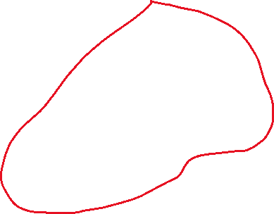

After adjusting element in the 3th position
4
4
I=3
7
3
7
8
6
10
2
3
6
10
2
8
5
1
9
5
1
9
4 | 7 | 8 | 6 | 10 | 2 | 3 | 5 | 1 | 9
1 | 2 | 3 | 4 | 5 | 6 | 7 | 8 | 9 | 10
After adjusting element in the 2nd position
4
4
I=2
4
10
8
10
8
7
8
6
7
2
3
6
9
2
3
6
10
2
3
5
1
9
5
1
9
5
1
7

Slide 42



After adjusting element in the 1st position
I=1
4
10
10
10
8
4
8
9
8
6
9
2
3
6
9
2
3
6
4
2
3
5
1
7
5
1
7
5
1
7
10
Initialization Completed
9
8
6
7
2
3
5
1
4
10 | 9 | 8 | 6 | 7 | 2 | 3 | 5 | 1 | 4
1 | 2 | 3 | 4 | 5 | 6 | 7 | 8 | 9 | 10

Slide 43


Max heap Tree Exchange and adjust: Iteration 1
10
After Exchange
4
After Adjust
9
9
8
9
8
7
8
6
7
2
3
6
7
2
3
6
4
2
3
5
1
4
5
1
10
5
1
9 | 7 | 8 | 6 | 4 | 2 | 3 | 5 | 1 | 10
1 | 2 | 3 | 4 | 5 | 6 | 7 | 8 | 9 | 10

Slide 44



Max heap Tree Exchange and Adjust: Iteration 2
9
After Exchange
1
After Adjust
8
7
8
7
8
7
3
6
4
2
1
6
4
2
3
6
4
2
3
5
5
9
5
1
8 | 7 | 3 | 6 | 4 | 2 | 1 | 5 | 9 | 10
1 | 2 | 3 | 4 | 5 | 6 | 7 | 8 | 9 | 10

Slide 45


Max heap Tree Exchange and Adjust: Iteration 3
8
After Exchange
5
After Adjust
7
7
3
6
3
7
3
6
4
2
1
5
4
2
1
6
4
2
1
8
5
7 | 6 | 3 | 5 | 4 | 2 | 1 | 8 | 9 | 10
1 | 2 | 3 | 4 | 5 | 6 | 7 | 8 | 9 | 10

Slide 46


Max heap Tree Exchange and Adjust: Iteration 4
After Exchange
After Adjust
6
7
1
6
3
6
3
5
3
5
4
2
1
5
4
2
7
1
4
2
6 | 5 | 3 | 1 | 4 | 2 | 7 | 8 | 9 | 10
1 | 2 | 3 | 4 | 5 | 6 | 7 | 8 | 9 | 10

Slide 47


Max heap Tree Exchange and Adjust: Iteration 5
After Exchange
After Adjust
6
2
5
5
3
5
3
4
3
1
4
2
1
4
6
1
2
5 | 4 | 3 | 1 | 2 | 6 | 7 | 8 | 9 | 10
1 | 2 | 3 | 4 | 5 | 6 | 7 | 8 | 9 | 10

Slide 48

Max heap Tree Exchange and Adjust: Iteration 6
After Exchange
2
After Adjust
4
5
2
3
4
3
4
3
1
1
5
1
2
4 | 2 | 3 | 1 | 5 | 6 | 7 | 8 | 9 | 10
1 | 2 | 3 | 4 | 5 | 6 | 7 | 8 | 9 | 10

Slide 49

Max heap Tree Exchange and Adjust:Iteration 7
After Exchange
After Adjust
3
4
1
2
3
2
3
2
1
4
1
3 | 2 | 1 | 4 | 5 | 6 | 7 | 8 | 9 | 10
1 | 2 | 3 | 4 | 5 | 6 | 7 | 8 | 9 | 10

Slide 50
Max heap Tree Exchange and Adjust :Iteration 8
1
2
3
After Exchange
After Adjust
2
3
1
2
1
2 | 1 | 3 | 4 | 5 | 6 | 7 | 8 | 9 | 10
1 | 2 | 3 | 4 | 5 | 6 | 7 | 8 | 9 | 10
Max heap Tree Exchange and Adjust : Itertion 9
1
1
2
2
1 | 2 | 3 | 4 | 5 | 6 | 7 | 8 | 9 | 10
1 | 2 | 3 | 4 | 5 | 6 | 7 | 8 | 9 | 10

Slide 51


Illustrate the execution of heap-sort algorithm for the following input sequence:
(2, 5, 16, 4, 10, 23, 39, 18, 26, 15).
Initial binary tree
Create initial heap tree
2
5
16
4
10
23
39
18
26
15
After adjusting element in the 5th position
2
2
i=5
i=5
5
16
5
16
4
4
15
23
39
10
23
39
18
26
15
18
26
10

Slide 52
Q. Explain the insertion and deletion operations on MaxHeap. b) Construct a max heap from the following numbers: 11, 6, 8, 19, 4, 10, 5, 17, 43, 49, 31

